Slide 1

DeFi ASSET MANAGEMENT
TT
TAILWIND TRADERS
THE FUTURE OF INVESTING
Notes:
Cindy

Slide 2

Executive Summary
Our team built a portfolio design system that leverages smart contracts and blockchain technology.
We validated portfolios with backtesting analysis based on our feedback from Project Two.
Our investment approach focuses on the efficient frontier, valuation, and price history analysis.
Broadly speaking, the information technology has produced the highest returns in the last few years.
Notes:
Cindy

Slide 3

TABLE OF CONTENTS
EXECUTIVE SUMMARY 2
SYSTEM DESCRIPTION 4-7
PORTFOLIO BUILDING APPROACH 8-11
BACKTESTING & VALIDATION 12-18
SMART CONTRACT 19
BLOCKCHAIN INTEGRATION 20
CONCLUSION 21
TT
TAILWIND TRADERS
Notes:
Cindy

Slide 4

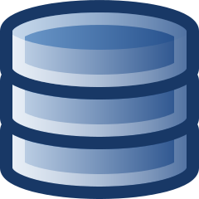

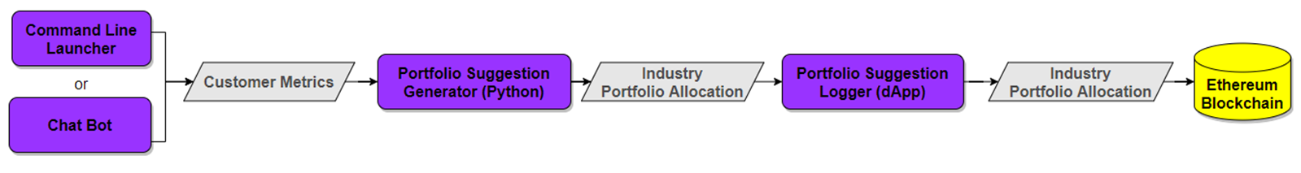
SYSTEM DESCRIPTION
Launcher
Two options exist to initiate the portfolio building process.
Command Line Launcher: Specify customer metrics and contract address through command line inputs.
Chat Bot: A chat bot interactively collects customer metrics and contract address from the user.
Notes:
David

Slide 5

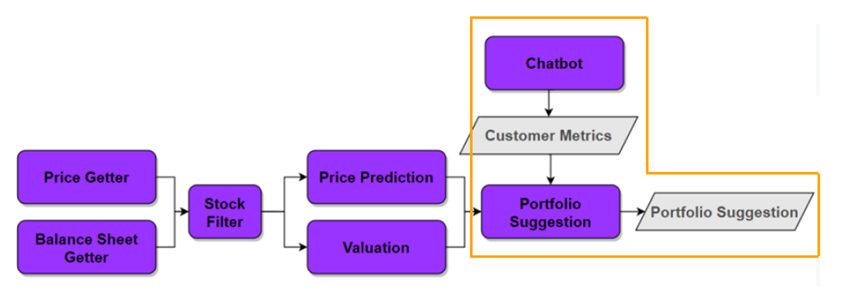
SYSTEM DESCRIPTION
This portfolio suggestion and logging capability augments the previous project effort as a nearly drop-in component replacement.
Notes:
David

Slide 6
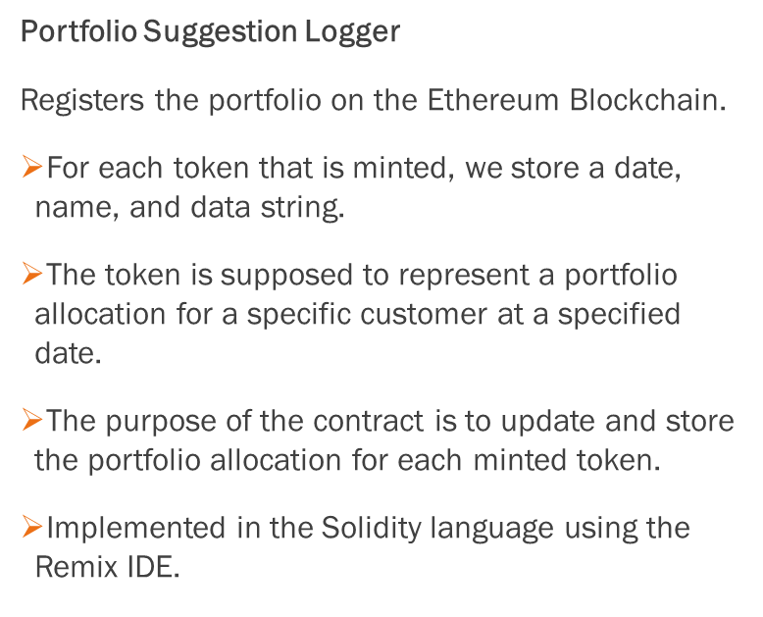
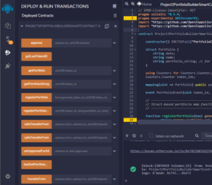
SYSTEM DESCRIPTION: INPUT
Notes:
Andrew

Slide 7
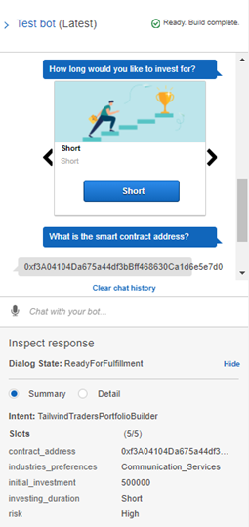
USER INTERFACE: OUTPUTS
Customer Metrics consisting of:
Risk: Integer indicating low (0), medium (1), and high (2) risk tolerance.
Initial_investment: Initial dollar investment.
Industries_preferences: List of preferred industries.
Investing_duration: Integer indicating short-term (0), medium-term (1), and long-term (2) investing duration.
Contract address: The address at which the smart contract is deployed.
Notes:
David

Slide 8
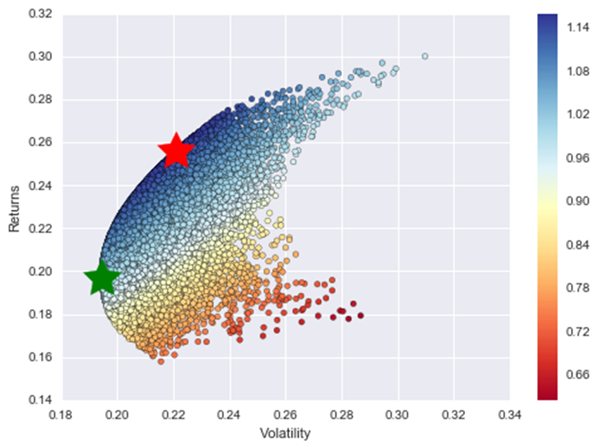
PORTFOLIO BUILDING APPROACH
EFFICIENT FRONTIER ALGORITHM
One of the hardest aspects of solving for an optimal portfolio is balancing risk and reward. This problem can be understood in terms of a convex optimization problem.
A set of convex optimization techniques have been developed to solve for an optimal portfolio. The General Efficient Frontier algorithm has a readily-available implementation and was selected as an initial solution.
The Efficient Frontier algorithm computes a sample covariance matrix based on industry price history and solves the optimization problem maximizing the Sharpe Ratio. This produces a weight vector representing the optimal allocation.
Notes:
Ibrahima

Slide 9
PORTFOLIO BUILDING DATA STUDY
To support system development, additional research and testing was performed.
Using a sample of stocks listed on the New York Stock Exchange (NYSE), a combination of Efficient Frontier and prioritization by company valuation was tested.
Found mixed results in previous 2 years due to extreme market volatility.
Future Research
Meaningful fundamental analysis varies for each industry. Automatic industry-specific handling should be integrated into the framework.
Evaluate seasonal trends and augment portfolio selection process.
All industries
506 companies listed on the NYSE.
Balance sheet and valuation analysis
Top 50 companies by fundamental analysis.
Efficient Frontier
Top ~63 companies by statistical price performance.
Notes:
Ibrahima

Slide 10
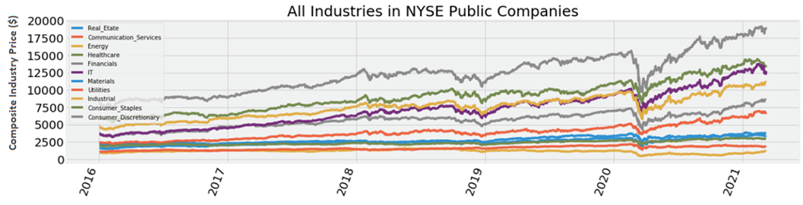
PORTFOLIO SUGGESTION GENERATOR
Uses the Efficient Frontier algorithm (described in other slides) to build a portfolio across industries based on industry performance and risk metrics.
Inputs:
Customer Metrics
Industry Price History
Outputs:
Industry Portfolio Allocation: Represented as a dictionary of industry names to integer number of shares allocated.
Notes:
Ibrahima

Slide 11
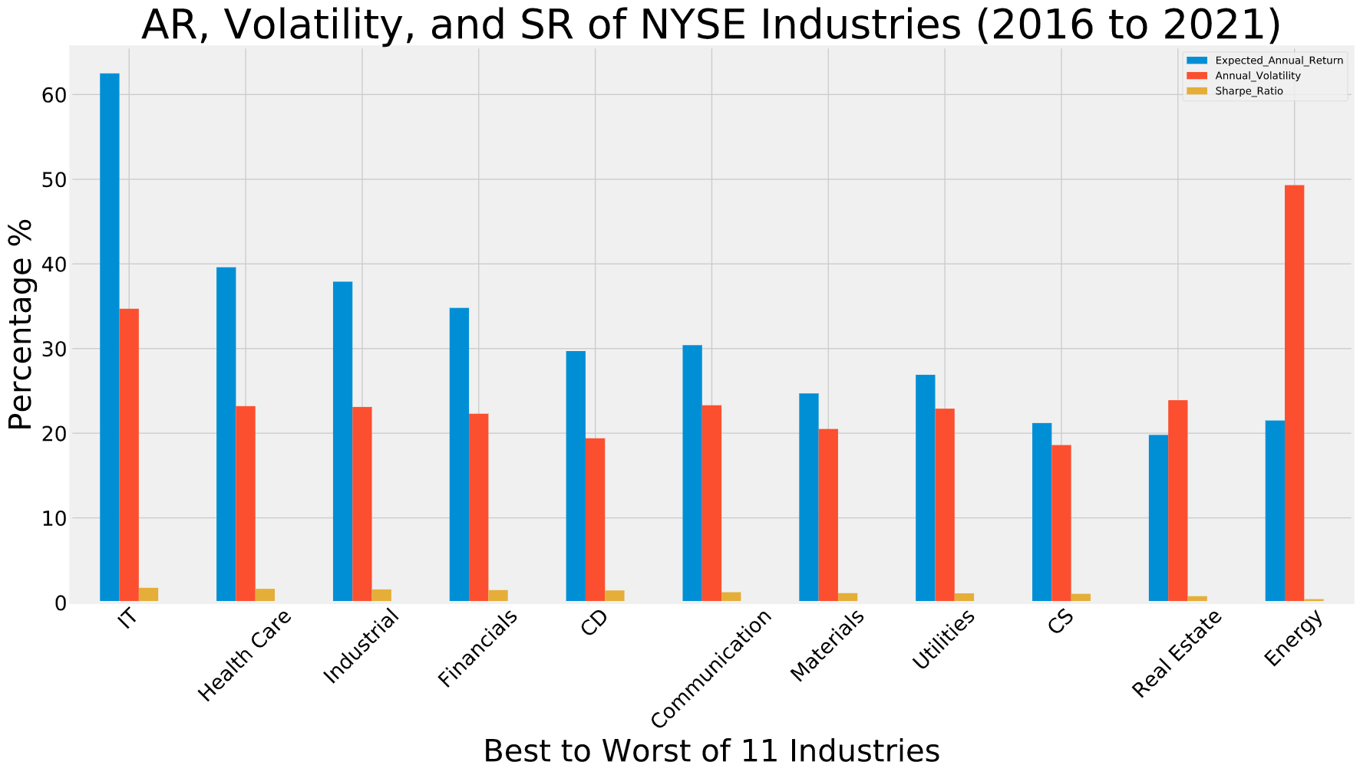
PORTFOLIO OPTIMIZATION
Optimizing a portfolio based on their performance from the highest expected return to the lowest given risk.
Notes:
Milad

Slide 12
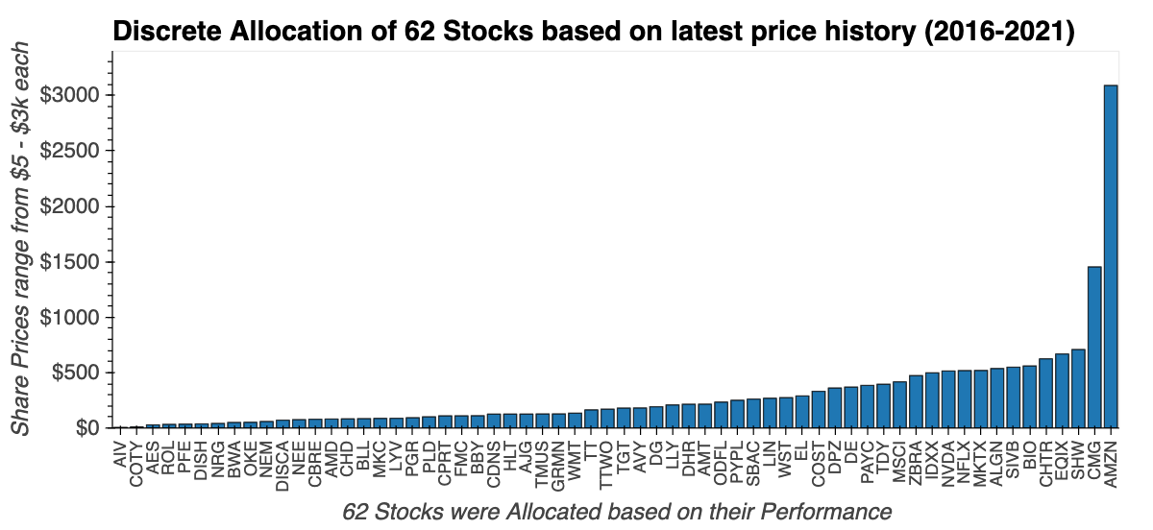
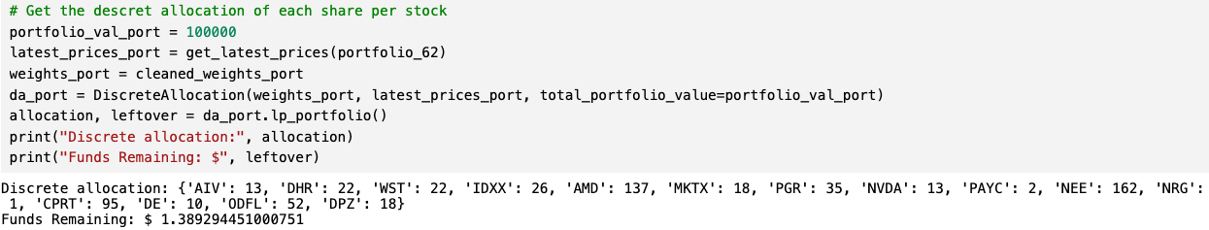
PORTFOLIO ALLOCATION
A Statistical Distribution of Best Performing Stocks from a total of 506 companies across 11 Industries resulting to 62 Stocks. Differs based on latest price and time!
Notes:
Milad

Slide 13
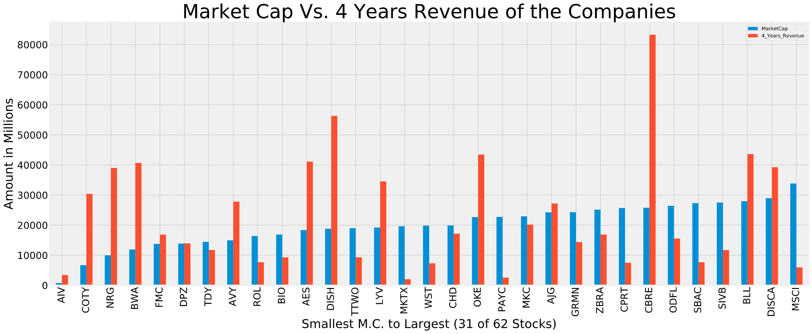
PORTFOLIO VALUATION
Using U.S. Securities and Exchange Commission website for the Company Valuation
Total Revenue Sales of the Company
Latest Quarter Balance Sheet of the Company
Notes:
Milad

Slide 14
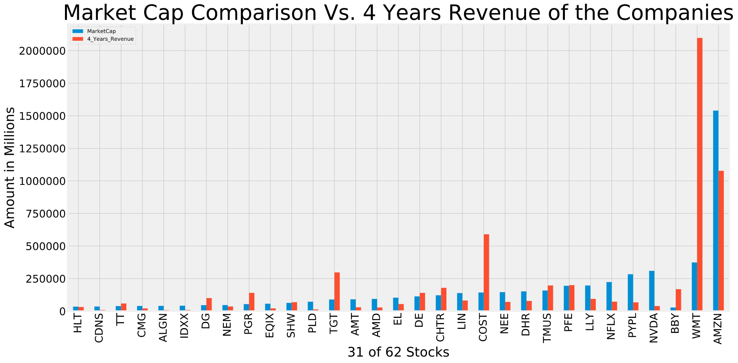
PORTFOLIO VALUATION
Using U.S. Securities and Exchange Commission website for the Company Valuation
Total Revenue Sales of the Company
Latest Quarter Balance Sheet of the Company
Notes:
Milad

Slide 15
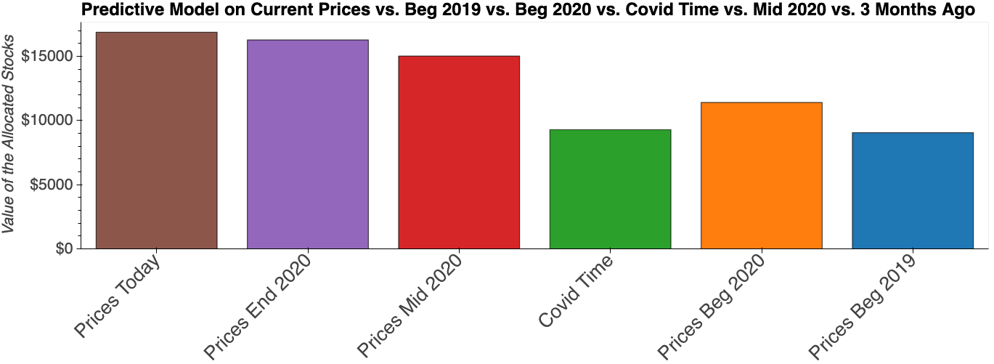
PORTFOLIO VALIDATION
Backtesting to historical data to determine for accuracy without the risk of Capital
Measures include net profit/loss, return, risk-adjusted return, market exposure, and volatility.
If you’d have bought 1 share of each 62 Stocks at certain times.
Backtesting the Past 2 Years of Historical Data
Notes:
Milad

Slide 16
PORTFOLIO VALIDATION
Based on Backtesting model here are the results / numbers:
Using at least the Past 2 Years Data
Quantitative Analysis on Real Time Data
Current Value | Percentage Change
$186,517 | 86.51%
If invested $100k in Beg 2019, you would have made…
If invested $100k in Beg 2020, you would have made…
Current Value | Percentage Change
$148,016 | 48.16%
If invested $100k in Covid Low (3/16/2020), you would have made…
Current Value | Percentage Change
$181,805 | 81.80%
If invested $100k in Mid 2020, you would have made…
Current Value | Percentage Change
$112,369 | 12.36%
If invested $100k in 3 Months Ago, you would have made…
Current Value | Percentage Change
$103,708 | 3.70%
Notes:
Jonathan

Slide 17
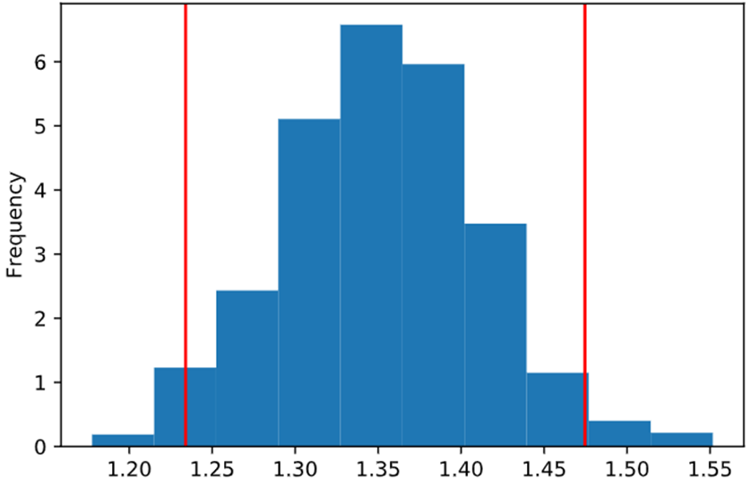
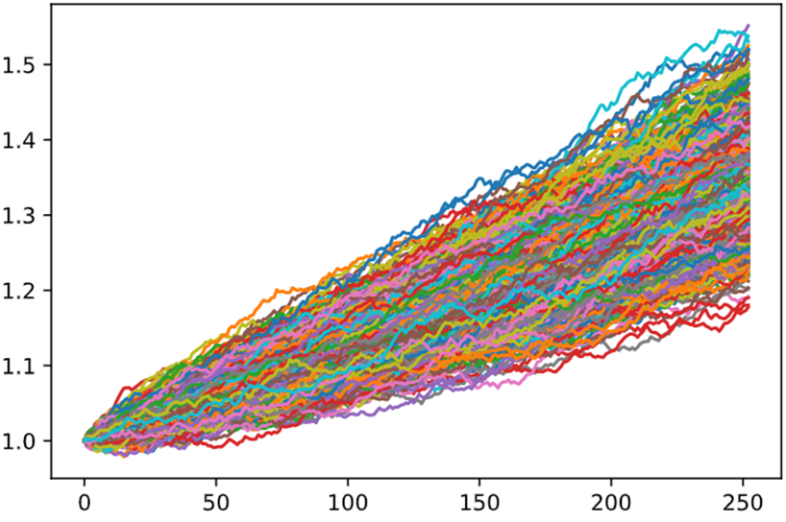
PORTFOLIO PREDICTION
MONTE-CARLO PROJECTION:
There is a 95% chance that an initial investment of $20,000 in this portfolio over the next 1 year will end within in the range of $24,679 and $29,492
Distribution of Final Cumulative Returns Across All 1000 Simulations
1000 Simulations of Cumulative Return Trajectories Over the Next 252 Trading Days
Mean of Price Trajectory
Standard Deviation
Price Prediction for the next 252 Days
Notes:
Milad

Slide 18
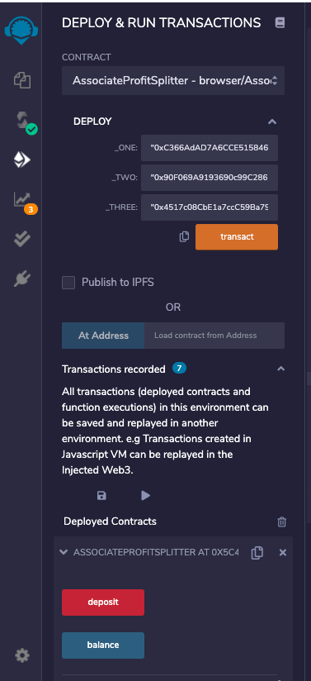
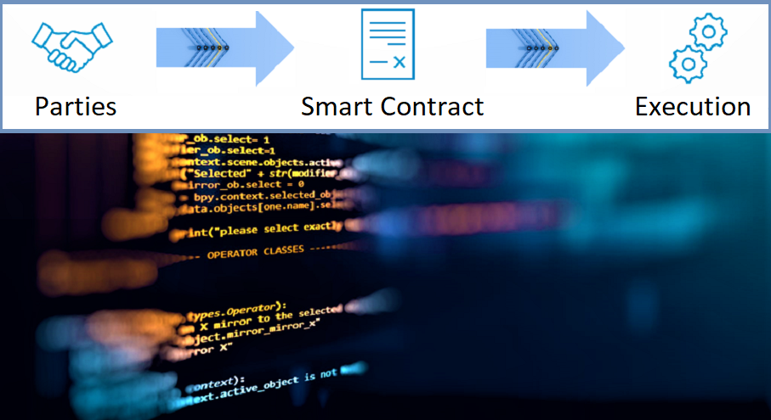
SMART CONTRACT DAPP
Enhances security
Streamlines operational processes
Ensures the highest quality of goods
Transparency
Simplifies B2B communications
Creates immutable records of transactions
Notes:
Andrew

Slide 19




BLOCKCHAIN INTEGRATION
Install Truffle Framework
Generate Code in Remix
Compile & Deploy Injected Web3
Meta Mask Wallet
Ganache
Solidity
Run DApp
METAMASK
Notes:
Andrew

Slide 20
CONCLUSION
Technology has revolutionized the financial industry in many ways, in addition to those mentioned in this presentation.
A Large amount of trading that occurs currently is run virtually entirely by machines.
This is a trend that will almost certainly continue to accelerate.
Notes:
Jonathan

Slide 21
Thank You.
TT
TAILWIND TRADERS
Notes:
Jonathan/Cindy

